Slide 1
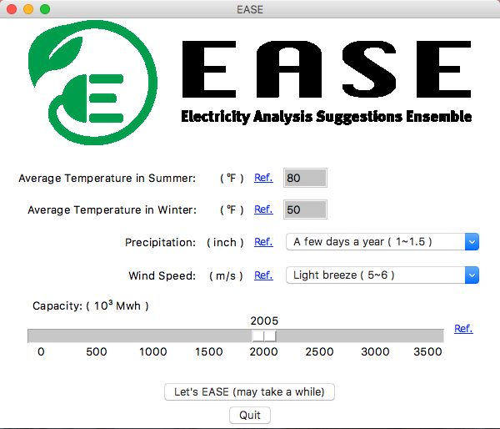
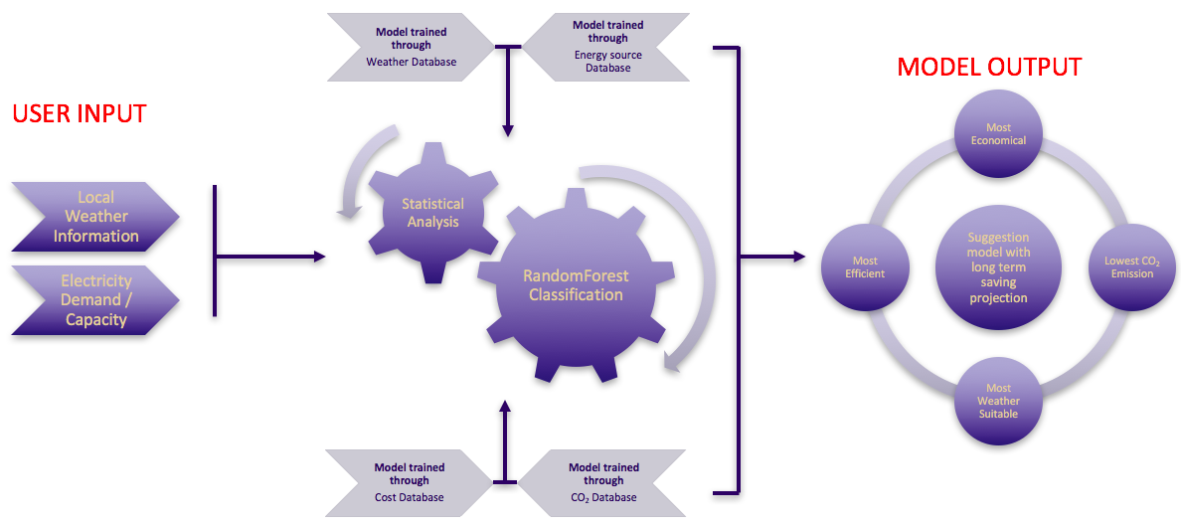
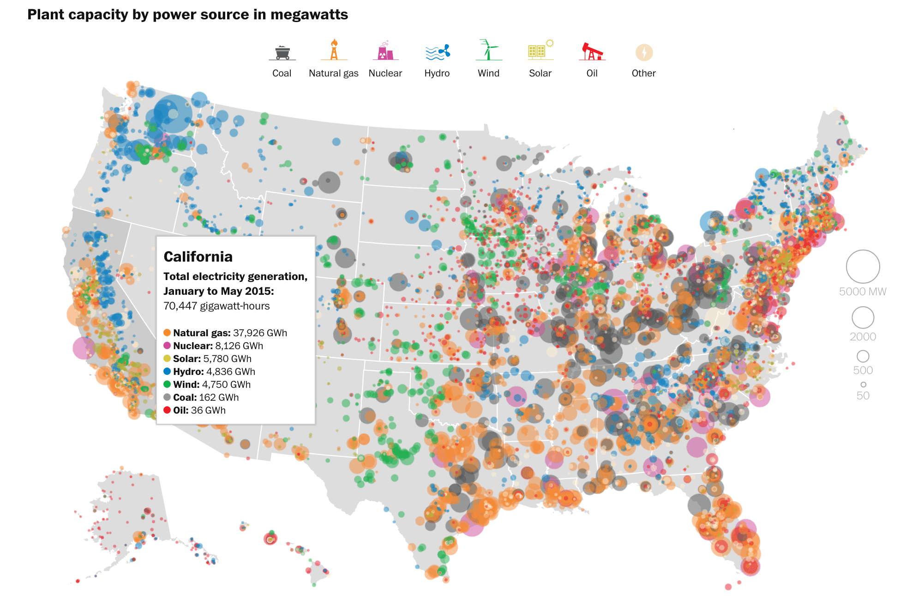
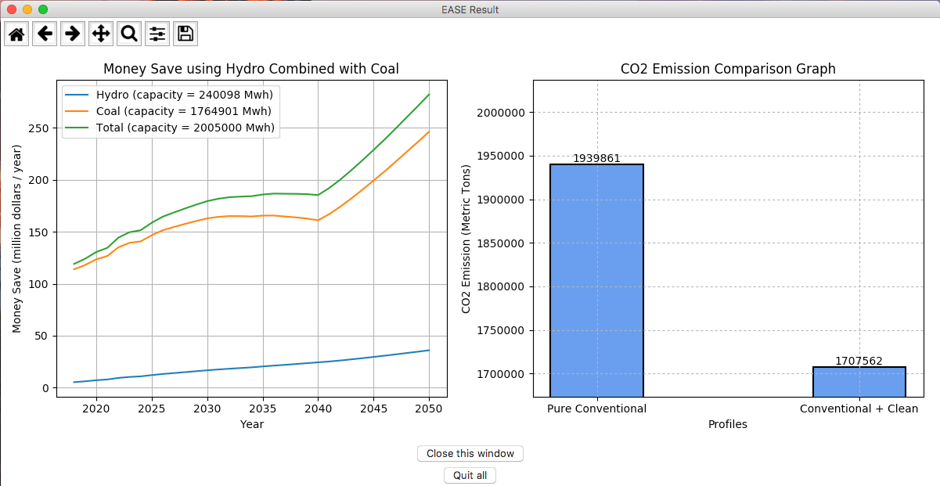

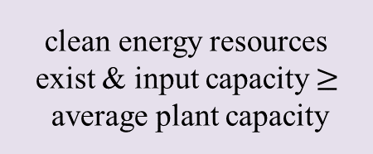
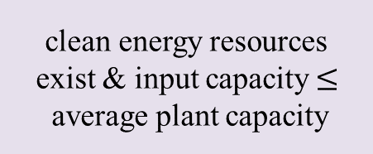
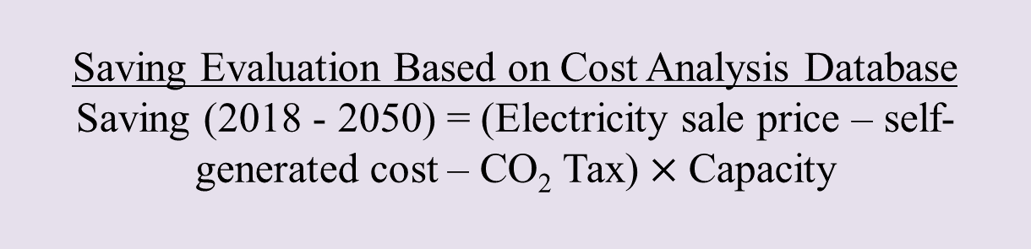
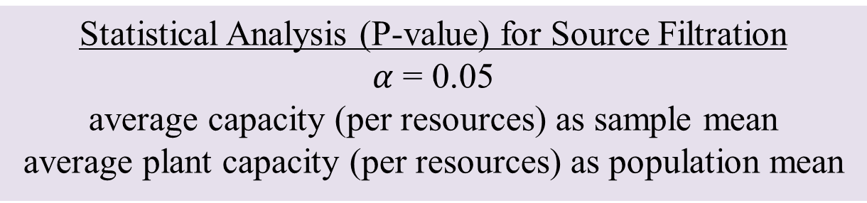
Electricity Analysis Suggestions Ensemble
Jiarong I. Cui Jiayuan Guo Tai-Yu D. Pan Yongquan Xie
Background / Challenges
Objective
Workflow
Results
Electricity is one of the major energies being utilized in governmental, residential, and Industrial sectors. Electricity can be generated from either conventional source (petroleum, coal, natural gas) or unconventional source (wind, hydro, solar). Conventionally generated electricity is accompanied by high CO₂ emission, often associated with different levels of CO₂ taxation depending on the state. Unconventionally generated electricity is often accompanied with various degree of costs (Installation, maintenance, and operational costs) and limitations such as weather, location, and technology.
The objective of EASE is to develop a suggestion model for industrial users who desire to construct an electricity generation plant to offset long term cost from buying electricity from the Government. EASE compiles user input weather and capacity information, outputs the best electricity generation source that is resource optimized, lowest cost, highest efficiency, and cleanest.
GUI Input Panel
EASE logo utilized a green outlet to symbolize electricity generation via green energy sources.
Data Mining
construct a dataframe contains weather information
EASE GUI first displayed license page in a pop-up window, then askes user to input weather and capacity information necessary for prediction and analysis.
RandomForest Classification
tree number = 5000
split data into 80:20 for training and testing
Figure 5. EASE GUI interactive panel
Figure 2. High level EASE model workflow
Statistical Analysis (P-value) for Source Filtration
$α$ = 0.05
average capacity (per resources) as sample mean
average plant capacity (per resources) as population mean
Machine Learning (RF)
Machine Learning (ML) is a method of data analysis that automates analytical model building. Using algorithms that iteratively learn from data thus allows computer to find hidden insights without explicit directions. Among all other machine learning classification algorithms, RandomForest is meta estimator that fits numerous decision tree classifiers on various sub-samples (m < M) of the dataset with bagging methods to improve the predictive accuracy and control overfitting through randomizations.
In EASE, a 260,000 by 6 (rows by columns) weather database is used to train the RF model. With user input weather information, EASE can then predict relative location and thus extrapolate possible energy resources that can be used as electricity generation. These possible energy resources will then be filtered through statistical analysis using p-values with 𝜶 = 0.05 to ensure model outputs an realistic suggestion sources.
Saving Evaluation Based on Cost Analysis Database
Saving (2018 - 2050) = (Electricity sale price – self-generated cost – CO₂ Tax)$×$Capacity
Figure 6. EASE suggestion output
EASE GUI output a suggestion on clean energy source and conventional source for electricity generation, provide long term cost analysis and CO₂ emission using conventional and an discouragement for pushing green.
Figure 1. united states electricity generation map
EASE is conceptualized based on the idea stemming from building a cleaner world with less greenhouse gas emission. Realizing that electricity is the major source of energy being consumed, and that the major component of the greenhouse gas is CO₂ when generating electricity from conventional sources. The proposal in introducing clean energy as electricity generation source as future industries thus become our major client pool. Therefore, EASE is developed with an aim to spread the principle of using cleaner energy sources for the better of our future.
The challenging parts are mainly come from the relationship analysis among input parameters, as well as how they affect the output of the model. Choosing a proper machine learning method to train and fit our real-world datasets can ensure the effectiveness and particularity of the predicted outcome. Additionally, being able to realize any inter-relationships between parameters prior to choosing the proper machine learning algorithm is the key to EASE success.
Resources Suggestion & Respective Revenue plot
Prioritize resources with highest P-value
compare input capacity with average plant capacity
Discussion
EASE is developed with an aim to ease greenhouse gas that contributes to the ongoing global warming trends. By targeting electricity generation, one of the major energy conversion that impacts every daily activities, EASE provides energy source suggestions combined with an cost analysis for building a better future. EASE utilized RandomForest Classification algorithm from SciKit-Learn, and other statistical methods to provide realistic output suggestions. The cost analysis model from EASE is largely built on 2015 plant capacity, cost, and electricity sale price values. An even more realistic approach of EASE can be done through acquiring a full set of the above mentioned values ranging from 1995 to 2015, and use them to create a time series prediction. Further development of EASE can be focus on tuning down the assumptions made in version 1.0 with time series predictions.
clean energy resources exist & input capacity$≤$average plant capacity
clean energy resources exist & input capacity$≥$average plant capacity
no clean energy resource
use top ranked clean for electricity generation and plot clean saving
use top ranked clean and conventional for electricity generation, plot conventional, clean and total saving
use top ranked conventional for electricity generation and plot conventional saving
EASE Suggestion Output
Figure 3. A schematic of RandomForest Classification
Figure 4. EASE workflow
This project was supported by the Data Intensive Research Enabling Clean Technology (DIRECT) program at the University of Washington, Seattle, WA.
Special thanks to Prof. David C. Beck and Prof. Jim Pfaendtner

